Slide 1
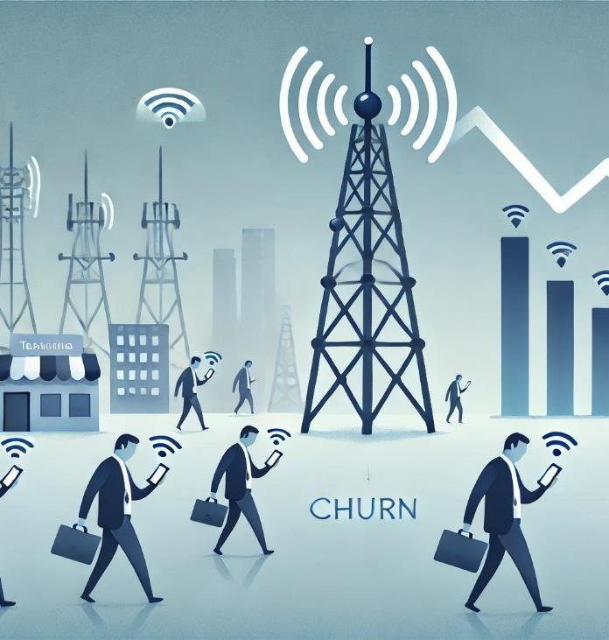
Telecom Churn
Group 6
Bollina Jaya Chandra
John Christopher J
Prekshitha Shetty C
Omkar Rajendra Sawant
Nagashree Hegde

Slide 2
Problem Overview:
Customer churn is a major challenge in the telecom industry, impacting revenue, customer lifetime value, and brand loyalty. Identifying at-risk customers is crucial for reducing churn and improving
retention strategies.
Objective:
Develop a machine learning model to predict customer churn using historical and behavioural data.

Slide 3
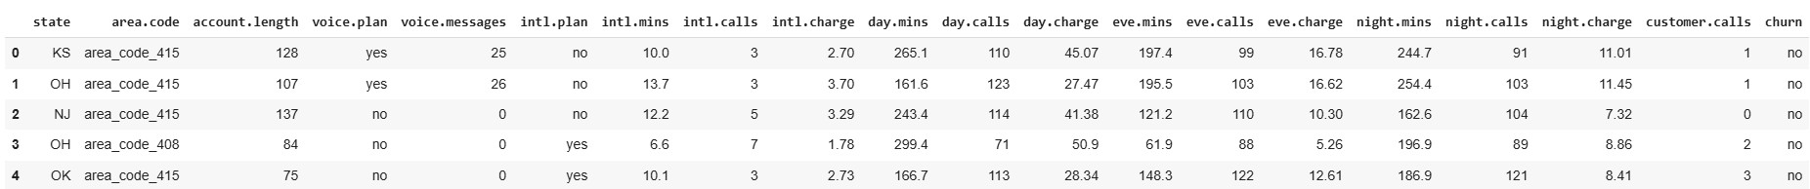
Overview of the data
Customer related details ├state Categorical, for the 51 states & District of Columbia ├area.code registered location ├account.length How long the account has been active Subscription plans ├voice.plan (Yes / No) ├intl.plan (Yes / No) Customer service interaction ├customer.calls number of calls to customer service. Churn status churn (Yes/No: Customer Left or Not) | Statistics columns ├ voice.messages (Count) International Calls ├ intl.mins, intl.calls, intl.charge Daytime Usage ├ day.mins, day.calls, day.charge Evening Usage ├ eve.mins, eve.calls, eve.charge Night Usage night.mins, night.calls, night.charge There are 5000 rows & 20 columns.

Slide 4
Overview of the data
Customer related details ├state Categorical, for the 51 states & District of Columbia ├area.code registered location ├account.length How long the account has been active Subscription plans ├voice.plan (Yes / No) ├intl.plan (Yes / No) Customer service interaction ├customer.calls number of calls to customer service. Churn status churn (Yes/No: Customer Left or Not) | Statistics columns ├ voice.messages (Count) International Calls ├ intl.mins, intl.calls, intl.charge Daytime Usage ├ day.mins, day.calls, day.charge Evening Usage ├ eve.mins, eve.calls, eve.charge Night Usage night.mins, night.calls, night.charge There are 5000 rows & 20 columns.

Slide 5
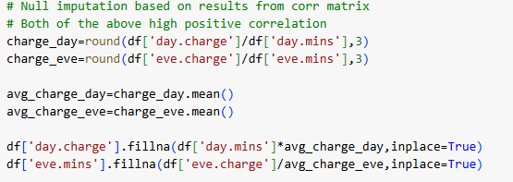

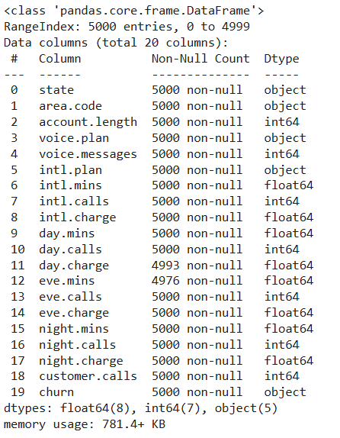



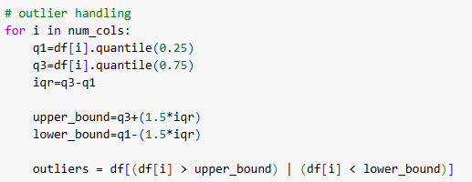
Exploratory Data Analysis
Drop column Unnamed: 0
Change misclassified datatypes
Null imputation
Duplicates handling
Outliers handling
Label encoding

Slide 6
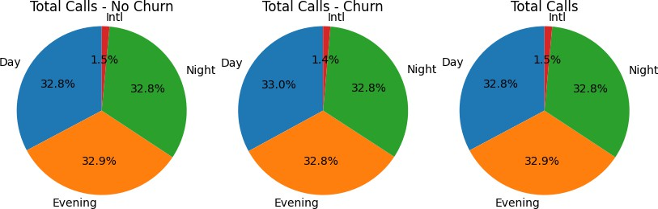
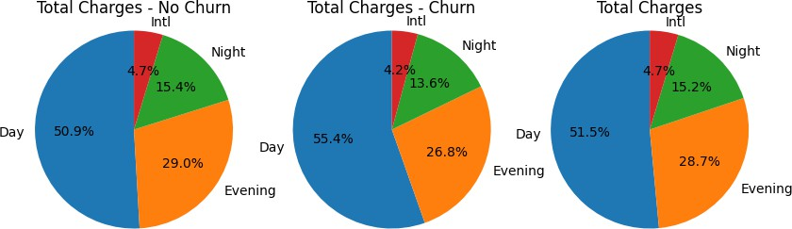
Visualizations Pie Charts
Pie charts effectively showcase the proportion of churned vs. retained customers, giving a quick overview of the problem.
Churned customers seem to generate more daytime charges but less evening and night usage, suggesting that their usage patterns might contribute to dissatisfaction or higher billing concerns.

Slide 7
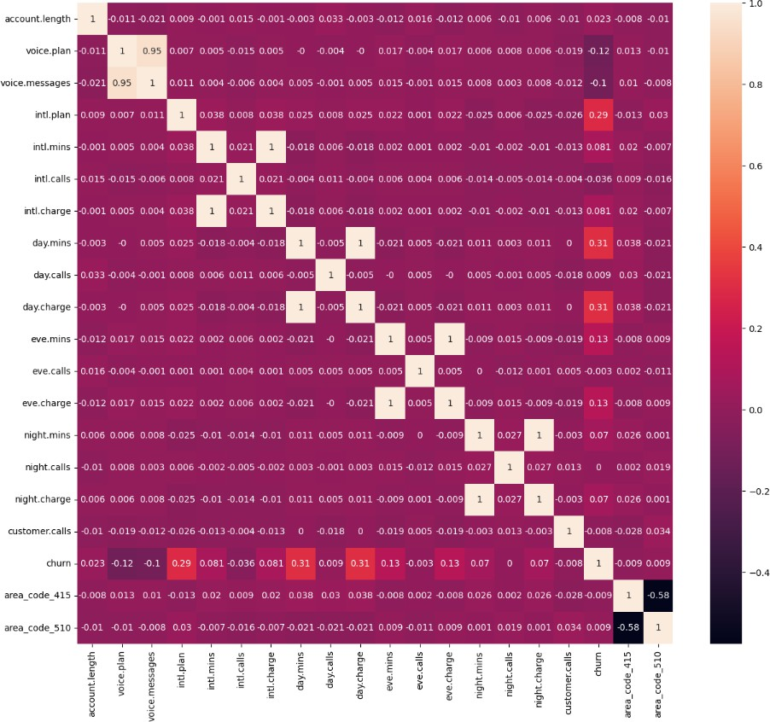
Visualizations Heatmap
Heatmaps visualize relationships between features, helping identify the most influential factors driving churn.
The positive correlation between international plans and churn suggests pricing, quality, or relevance of these plans could be driving dissatisfaction.

Slide 8
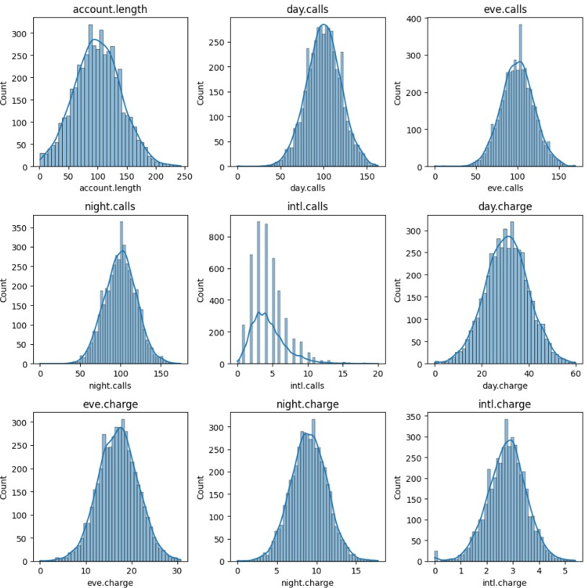
Visualizations Histograms
Histograms help analyze the distribution of numerical features like various charges and others, revealing trends among churned customers.
Day, evening, and night call distributions are similar, indicating consistent usage across time periods.
International calls and charges are rare, with only a small number of customers making frequent international calls.

Slide 9

Feature Selection & Preprocessing
Select KBest features
['day.mins', 'day.charge' , 'voice.messages', 'eve.mins', 'intl.plan ','night.mins']
Recursive feature elimination
['voice.plan', 'intl.plan', 'intl.calls', 'day.mins', 'area_code_415', 'area_code_510']
Decision tree
['day.charge', 'intl.mins', 'eve.charge', 'intl.calls', 'intl.plan', 'voice.messages']
Union of features from above three techniques
Applied MinMax Normalization on above features

Slide 10
Model Building & Evaluation
Random Forest
K Nearest Neighbors
Logistic Regression
Support Vector Machine
XGBoost
Artificial Neural Networks
Method | Accurac y score | Precision |  | Recall |  | F1-Score
 |  | 0 | 1 | 0 | 1 | 0 | 1
Random Forest | 0.97 | 0.96 | 1.00 | 1.00 | 0.75 | 0.98 | 0.86
KNN | 0.92 | 0.92 | 0.86 | 0.99 | 0.45 | 0.95 | 0.59
Logistic Regression | 0.90 | 0.91 | 0.78 | 0.98 | 0.35 | 0.95 | 0.48
SVM | 0.95 | 0.96 | 0.90 | 0.99 | 0.73 | 0.97 | 0.80
XG Boost | 0.97 | 0.96 | 1.00 | 1.00 | 0.75 | 0.98 | 0.86
ANN | 0.95 | 0.96 | 0.84 | 0.98 | 0.74 | 0.97 | 0.78

Slide 11
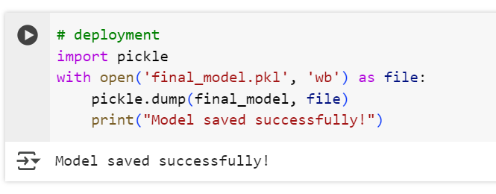
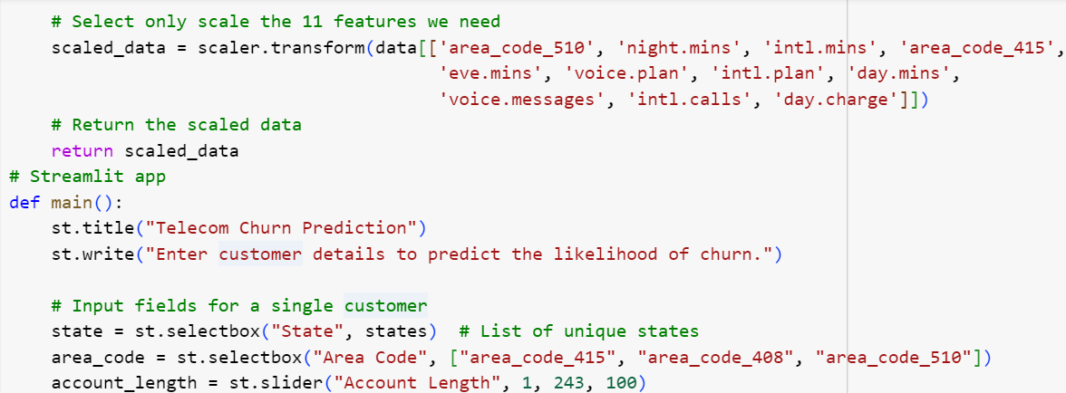
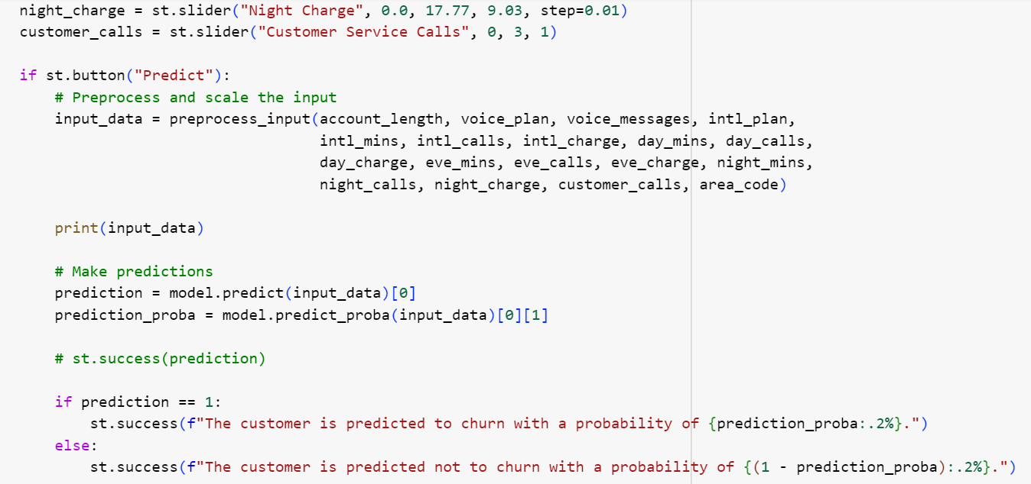
Model Deployment using streamlit

Slide 12
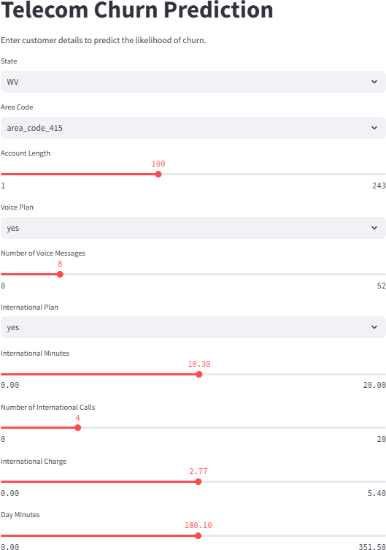
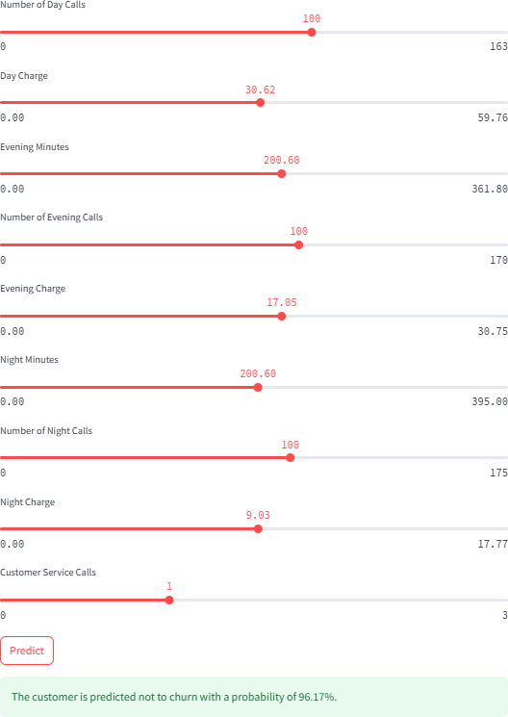


Deployment

Slide 13
Conclusion
By implementing these insights, telecom companies can proactively address customer concerns, refine service offerings, and design targeted retention strategies to minimize churn and maximize customer satisfaction

Slide 14
Thank You
Bollina Jaya Chandra John Christopher J Prekshitha Shetty C Omkar Rajendra Sawant Nagashree Hegde

